Slide 1





Module 01 – Working with Database
WWW.SELACLOUD.COM

Slide 2

What is Data?
Data refers to information in a structured or unstructured form that can be processed or analyzed.
In programming, data is essential for storing, retrieving, and manipulating information in applications.
Examples of data include text, numbers, images, audio, and more.

Slide 3
Databases
Introduction to Databases
A database is an organized collection of data stored and accessed electronically.
Databases are used to efficiently manage and retrieve large amounts of information.
They provide a structured way to store data, making it easier to organize and query.
Notes:
Python is dynamically-typed and garbage-collected. It supports multiple programming paradigms, including structured (particularly, procedural), object-oriented and functional programming.
It was built to be as readable as possible, and is significant indentation driven (Off-side rule).
The language's core philosophy is summarized in the document The Zen of Python (PEP 20), which includes aphorisms such as:
Beautiful is better than ugly.
Explicit is better than implicit.
Simple is better than complex.
Complex is better than complicated.
Readability counts.
For further reading:
Python (programming language) - Wikipedia

Slide 4
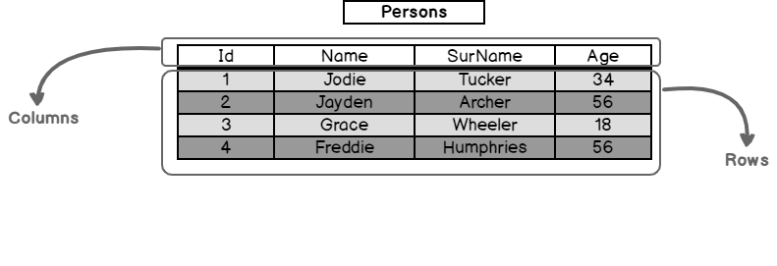
Database Basics
Understanding Databases
Tables: A table is a structured collection of related data organized in rows and columns. Each column represents a specific attribute or property of the data, and each row represents a record or instance.
Fields/Columns: Fields are the individual attributes or properties of a record. They define the type of data that can be stored.
Records/Rows: Records are the individual instances or entries in a table, containing values for each field.
Primary Key: A primary key is a unique identifier for each record in a table. It ensures that each record can be uniquely identified.
Foreign Key: A foreign key is a field that references the primary key of another table, establishing a relationship between the two tables.
Notes:
Python is dynamically-typed and garbage-collected. It supports multiple programming paradigms, including structured (particularly, procedural), object-oriented and functional programming.
It was built to be as readable as possible, and is significant indentation driven (Off-side rule).
The language's core philosophy is summarized in the document The Zen of Python (PEP 20), which includes aphorisms such as:
Beautiful is better than ugly.
Explicit is better than implicit.
Simple is better than complex.
Complex is better than complicated.
Readability counts.
For further reading:
Python (programming language) - Wikipedia

Slide 5
Connecting to DB from Python
Connecting to a Database from Python
To work with databases in Python, we need to establish a connection to the database.
We import the necessary modules, such as mysql.connector or pymysql, to interact with the specific database.
We create a connection object by providing the required credentials, such as the host, username, password, and database name.
Once the connection is established, we can perform various operations on the database.

Slide 6
Connecting to MySQL DB
Connecting to a MySQL Database
We focus on connecting to a MySQL database using Python.
We import the mysql.connector module, specifically designed for connecting to MySQL databases.
We create a connection object using the mysql.connector.connect() method and passing the necessary parameters, including host, username, password, and database name.
We demonstrate the connection process through sample code, ensuring that the connection is successfully established.
We also discuss error handling and exceptions that may occur during the connection process.
Notes:
PyCharm is currently one of the most used IDE for python development, It provides code analysis, a graphical debugger, an integrated unit tester, integration with version control systems (VCSes), and supports web development with Django as well as data science with Anaconda.
It was created by JetBrains
It is mostly popular because of many things, such as:
It is considered as an intelligent code editor, fast and safe refactoring, and smart code.
Features for debugging, profiling, remote development, testing the code, auto code completion, quick fixing, error detection and tools of the database.
Support for Popular web technologies, web frameworks, scientific libraries and version control.

Slide 7
Connecting to MySQL DB

Slide 8
Connecting to MySQL DB
import mysql.connector # Step 1: Import the required module import mysql.connector # Step 2: Create a connection object connection = mysql.connector.connect( host="localhost", user="your_username", password="your_password", database="your_database" ) # Step 3: Check if the connection was successful if connection.is_connected(): print("Successfully connected to the database!") else: print("Failed to connect to the database.")

Slide 9
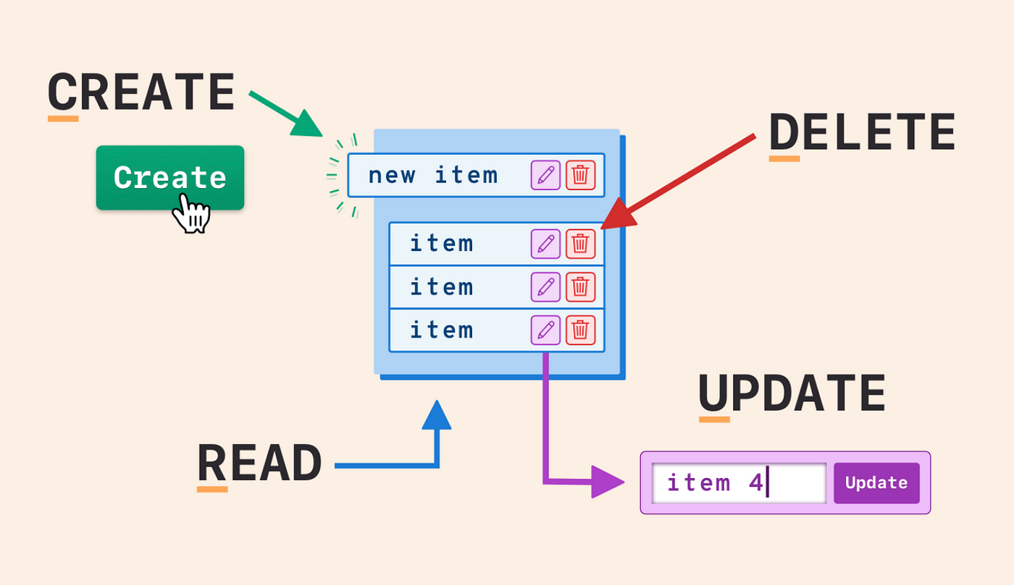
CRUD Operations
Performing CRUD Operations
CRUD stands for Create, Read, Update, and Delete, which are fundamental operations in database management.
Create: Inserting new records into a database.
Read: Retrieving or querying data from a database.
Update: Modifying existing records in a database.
Delete: Removing records from a database.
These operations allow us to interact with the data and manipulate it as needed.
Notes:
PyCharm is currently one of the most used IDE for python development, It provides code analysis, a graphical debugger, an integrated unit tester, integration with version control systems (VCSes), and supports web development with Django as well as data science with Anaconda.
It was created by JetBrains
It is mostly popular because of many things, such as:
It is considered as an intelligent code editor, fast and safe refactoring, and smart code.
Features for debugging, profiling, remote development, testing the code, auto code completion, quick fixing, error detection and tools of the database.
Support for Popular web technologies, web frameworks, scientific libraries and version control.

Slide 10
Performing CRUD Operations on MySQL DB
Performing CRUD Operations on a MySQL Database
We dive into performing CRUD operations specifically on a MySQL database using Python.
Create: We demonstrate how to insert new records into the database using INSERT statements.
Read: We explain the process of executing SELECT queries to retrieve data from the database.
Update: We illustrate how to update existing records using UPDATE statements.
Delete: We show how to delete records from the database using DELETE statements.
We provide code examples and highlight important considerations for each operation.
Notes:
PyCharm is currently one of the most used IDE for python development, It provides code analysis, a graphical debugger, an integrated unit tester, integration with version control systems (VCSes), and supports web development with Django as well as data science with Anaconda.
It was created by JetBrains
It is mostly popular because of many things, such as:
It is considered as an intelligent code editor, fast and safe refactoring, and smart code.
Features for debugging, profiling, remote development, testing the code, auto code completion, quick fixing, error detection and tools of the database.
Support for Popular web technologies, web frameworks, scientific libraries and version control.

Slide 11
Create Operations
SQL INSERT Statement:
The SQL INSERT statement is used to add new records to a database table.
It allows you to specify the table name and the values to be inserted into the columns.
Syntax of the INSERT Statement:
The basic syntax of the INSERT statement is as follows:
INSERT INTO table_name (column1, column2, column3, ...) VALUES (value1, value2, value3, ...);
Using Python to Execute the INSERT Statement:
We can use the "MySQL Connector/Python" library to execute SQL statements from Python.
First, establish a connection to the MySQL database.
Then, create a cursor object to execute SQL queries.
Finally, execute the INSERT statement using the cursor's execute() method.
Notes:
PyCharm is currently one of the most used IDE for python development, It provides code analysis, a graphical debugger, an integrated unit tester, integration with version control systems (VCSes), and supports web development with Django as well as data science with Anaconda.
It was created by JetBrains
It is mostly popular because of many things, such as:
It is considered as an intelligent code editor, fast and safe refactoring, and smart code.
Features for debugging, profiling, remote development, testing the code, auto code completion, quick fixing, error detection and tools of the database.
Support for Popular web technologies, web frameworks, scientific libraries and version control.

Slide 12
Create Operations

Slide 13
Create Operations
import mysql.connector # Establish a connection to the database connection = mysql.connector.connect( host='localhost', user='username', password='password', database='database_name' ) # Create a cursor object cursor = connection.cursor() # Execute the INSERT statement insert_query = "INSERT INTO employees (id, name, salary) VALUES (1, 'John Doe', 50000);" cursor.execute(insert_query) # Commit the changes to the database connection.commit() # Close the cursor and the connection cursor.close() connection.close()
Remember to replace 'localhost', 'username', 'password', and 'database_name' with your actual connection details.
The execute() method is used to execute SQL statements.
After executing the INSERT statement, don't forget to call commit() to save the changes.
Close the cursor and the connection once you're done with the database operations.
Notes:
PyCharm is currently one of the most used IDE for python development, It provides code analysis, a graphical debugger, an integrated unit tester, integration with version control systems (VCSes), and supports web development with Django as well as data science with Anaconda.
It was created by JetBrains
It is mostly popular because of many things, such as:
It is considered as an intelligent code editor, fast and safe refactoring, and smart code.
Features for debugging, profiling, remote development, testing the code, auto code completion, quick fixing, error detection and tools of the database.
Support for Popular web technologies, web frameworks, scientific libraries and version control.

Slide 14
Read Operations
SQL SELECT Statement:
The SQL SELECT statement is used to retrieve records from a database table.
It allows you to specify the columns to be selected and apply conditions to filter the results.
Syntax of the SELECT Statement:
The basic syntax of the SELECT statement is as follows:
SELECT column1, column2, ... FROM table_name WHERE condition;
Using Python to Execute the SELECT Statement:
We can use the "MySQL Connector/Python" library to execute SQL statements from Python.
First, establish a connection to the MySQL database.
Then, create a cursor object to execute SQL queries.
Finally, execute the SELECT statement using the cursor's execute() method.
Notes:
PyCharm is currently one of the most used IDE for python development, It provides code analysis, a graphical debugger, an integrated unit tester, integration with version control systems (VCSes), and supports web development with Django as well as data science with Anaconda.
It was created by JetBrains
It is mostly popular because of many things, such as:
It is considered as an intelligent code editor, fast and safe refactoring, and smart code.
Features for debugging, profiling, remote development, testing the code, auto code completion, quick fixing, error detection and tools of the database.
Support for Popular web technologies, web frameworks, scientific libraries and version control.

Slide 15
Read Operations

Slide 16
Read Operations
import mysql.connector # Establish a connection to the database connection = mysql.connector.connect( host='localhost', user='username', password='password', database='database_name' ) # Create a cursor object cursor = connection.cursor() # Execute the SELECT statement select_query = "SELECT id, name, salary FROM employees;" cursor.execute(select_query) # Fetch all the rows from the result set rows = cursor.fetchall() # Process and display the retrieved records for row in rows: print(f"ID: {row[0]}, Name: {row[1]}, Salary: {row[2]}") # Close the cursor and the connection cursor.close() connection.close()
After executing the SELECT statement, we use the fetchall() method to retrieve all the rows from the result set.
You can then process the rows as per your requirements, such as displaying them or performing further calculations.
Notes:
PyCharm is currently one of the most used IDE for python development, It provides code analysis, a graphical debugger, an integrated unit tester, integration with version control systems (VCSes), and supports web development with Django as well as data science with Anaconda.
It was created by JetBrains
It is mostly popular because of many things, such as:
It is considered as an intelligent code editor, fast and safe refactoring, and smart code.
Features for debugging, profiling, remote development, testing the code, auto code completion, quick fixing, error detection and tools of the database.
Support for Popular web technologies, web frameworks, scientific libraries and version control.

Slide 17
Update Operations
SQL UPDATE Statement:
The SQL UPDATE statement is used to modify existing records in a database table.
It allows you to specify the table name, columns to be updated, and the new values.
Syntax of the UPDATE Statement:
The basic syntax of the UPDATE statement is as follows:
UPDATE table_name SET column1 = value1, column2 = value2, ... WHERE condition;
Using Python to Execute the UPDATE Statement:
We can use the "MySQL Connector/Python" library to execute SQL statements from Python.
First, establish a connection to the MySQL database.
Then, create a cursor object to execute SQL queries.
Finally, execute the UPDATE statement using the cursor's execute() method.
Notes:
PyCharm is currently one of the most used IDE for python development, It provides code analysis, a graphical debugger, an integrated unit tester, integration with version control systems (VCSes), and supports web development with Django as well as data science with Anaconda.
It was created by JetBrains
It is mostly popular because of many things, such as:
It is considered as an intelligent code editor, fast and safe refactoring, and smart code.
Features for debugging, profiling, remote development, testing the code, auto code completion, quick fixing, error detection and tools of the database.
Support for Popular web technologies, web frameworks, scientific libraries and version control.

Slide 18
Update Operations

Slide 19
Update Operations
import mysql.connector # Establish a connection to the database connection = mysql.connector.connect( host='localhost', user='username', password='password', database='database_name' ) # Create a cursor object cursor = connection.cursor() # Execute the UPDATE statement update_query = "UPDATE employees SET salary = 60000 WHERE id = 1;" cursor.execute(update_query) # Commit the changes to the database connection.commit() # Close the cursor and the connection cursor.close() connection.close()
Notes:
PyCharm is currently one of the most used IDE for python development, It provides code analysis, a graphical debugger, an integrated unit tester, integration with version control systems (VCSes), and supports web development with Django as well as data science with Anaconda.
It was created by JetBrains
It is mostly popular because of many things, such as:
It is considered as an intelligent code editor, fast and safe refactoring, and smart code.
Features for debugging, profiling, remote development, testing the code, auto code completion, quick fixing, error detection and tools of the database.
Support for Popular web technologies, web frameworks, scientific libraries and version control.

Slide 20
Delete Operations
SQL DELETE Statement:
The SQL DELETE statement is used to remove records from a database table.
It allows you to specify the table name and the conditions to identify the records to be deleted.
Syntax of the DELETE Statement:
The basic syntax of the DELETE statement is as follows:
DELETE FROM table_name WHERE condition;
Using Python to Execute the DELETE Statement:
We can use the "MySQL Connector/Python" library to execute SQL statements from Python.
First, establish a connection to the MySQL database.
Then, create a cursor object to execute SQL queries.
Finally, execute the DELETE statement using the cursor's execute() method.
Notes:
PyCharm is currently one of the most used IDE for python development, It provides code analysis, a graphical debugger, an integrated unit tester, integration with version control systems (VCSes), and supports web development with Django as well as data science with Anaconda.
It was created by JetBrains
It is mostly popular because of many things, such as:
It is considered as an intelligent code editor, fast and safe refactoring, and smart code.
Features for debugging, profiling, remote development, testing the code, auto code completion, quick fixing, error detection and tools of the database.
Support for Popular web technologies, web frameworks, scientific libraries and version control.

Slide 21
Delete Operations

Slide 22
Delete Operations
import mysql.connector # Establish a connection to the database connection = mysql.connector.connect( host='localhost', user='username', password='password', database='database_name' ) # Create a cursor object cursor = connection.cursor() # Execute the DELETE statement delete_query = "DELETE FROM employees WHERE id = 1;" cursor.execute(delete_query) # Commit the changes to the database connection.commit() # Close the cursor and the connection cursor.close() connection.close()
The execute() method is used to execute SQL statements.
After executing the DELETE statement, don't forget to call commit() to save the changes.
Ensure the condition in the WHERE clause correctly identifies the records to be deleted.
Notes:
PyCharm is currently one of the most used IDE for python development, It provides code analysis, a graphical debugger, an integrated unit tester, integration with version control systems (VCSes), and supports web development with Django as well as data science with Anaconda.
It was created by JetBrains
It is mostly popular because of many things, such as:
It is considered as an intelligent code editor, fast and safe refactoring, and smart code.
Features for debugging, profiling, remote development, testing the code, auto code completion, quick fixing, error detection and tools of the database.
Support for Popular web technologies, web frameworks, scientific libraries and version control.

Slide 23
Recap and Key Takeaways
Recap of the covered topics
We summarize the main points discussed, including data, databases, connecting to a database from Python, and performing CRUD operations on a MySQL database.
Key takeaways
We highlight the key concepts and insights that students should remember.
Emphasize the importance of understanding data and working with databases in Python.
Encouragement for further exploration
We encourage students to continue exploring and practicing with databases and Python, as it is a valuable skill in many domains.
Notes:
PyCharm is currently one of the most used IDE for python development, It provides code analysis, a graphical debugger, an integrated unit tester, integration with version control systems (VCSes), and supports web development with Django as well as data science with Anaconda.
It was created by JetBrains
It is mostly popular because of many things, such as:
It is considered as an intelligent code editor, fast and safe refactoring, and smart code.
Features for debugging, profiling, remote development, testing the code, auto code completion, quick fixing, error detection and tools of the database.
Support for Popular web technologies, web frameworks, scientific libraries and version control.

Slide 24
Lab 01

